Slide 1
Laundry Now
Senior Design Project Proposal Submitted By:
Frank Monforte, Ryan Russell
Sonoma State University Department of Engineering Science
Advisor: Dr. Farid Farahmand
Client: Tramaine Austin-Dillon
SSU Residential Area Coordinator – Sauvignon Village East
laundrynowssu.weebly.com
laundrynowssu@gmail.com

Slide 2
Overview
Problem and Solution
General System Overview
In Depth System Description and Technical Components
Sensors, Controllers, Server
Testing and Results
Materials and Costs
Timeline
Potential Risks
Conclusion

Slide 3
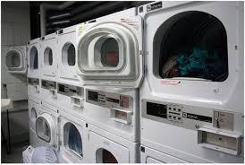
The Problem
6 Million People in California Living in Aparments.
No Way to Determine if Wahers or Dryers are Available for Use Without Making a Trip to the Laundry Room
Difficult for Management to Keep Track of Which Machines are Being Used the Most (Maintinence and Repairs) and Which Machines May be Broken Down

Slide 4
The Solution
Simple for Residents to Use and Reliable
Expandable Based on Number of Machines
Non-Invasive Design
Inexpensive to Purchase and Install
Allow Property Management to Track Machine Use
Design an easy to install, inexpensive monitoring system that allows users to check the status of machines in the laundry room. Include usage count so management can see which machines are being used the most (maintinence and repairs).

Slide 5
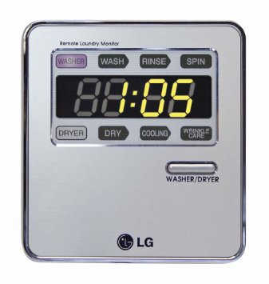
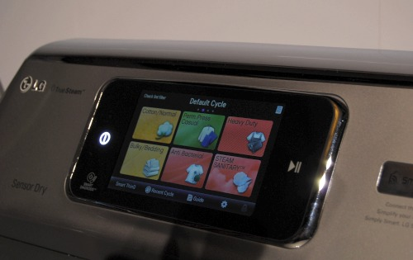
Existing Products
LaundryView by Mac-Grey Corp.
Designed To Work With Their Supplied Washers/Dryers
Allows Users To See What Machines Are Running/Time Left
Costly, Requires Wi-Fi Enabled Washers/Dryers
Remote Laundry Monitoring System by LG
Invasive (Modems Need To Be Installed On Machines)
Only In Home
Requires An Extra Plug In Unit

Slide 6
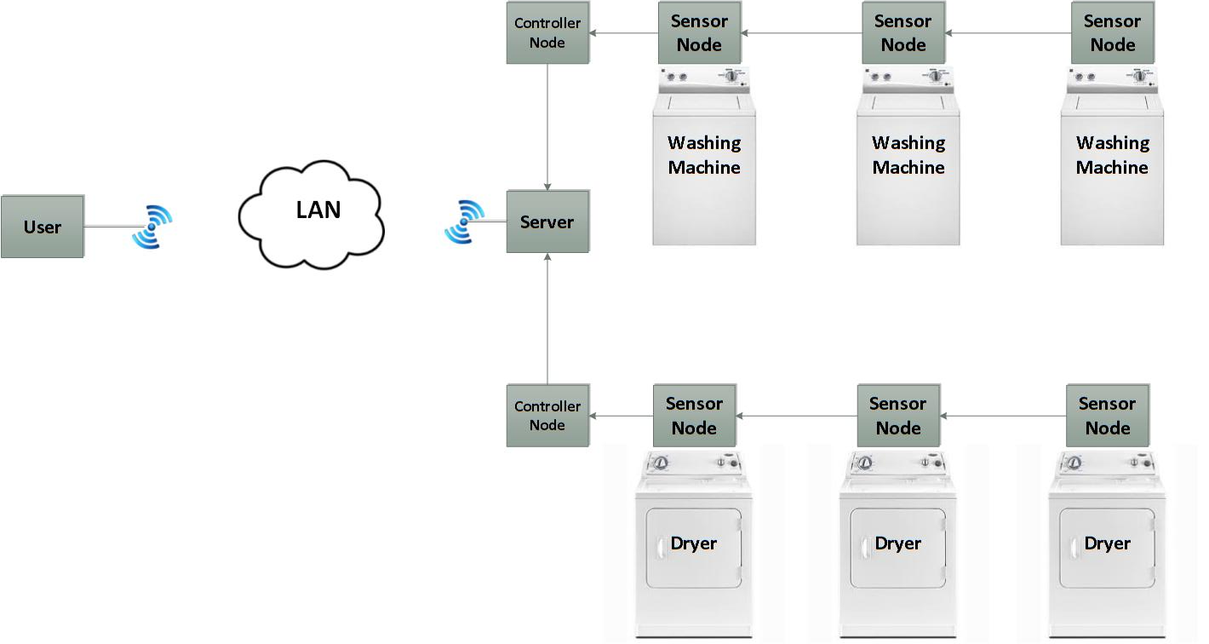
Basic Implementation

Slide 7
System Overview
3 Main Components
Server, Controller Node, Sensor Node
Sensor Node on Each Washer/Dryer
Sensor Nodes Connected to Controller Node
Up to 8 Sensors per Controller Node
Each Controller Node Connected to a Server
Up to 4 Controller Nodes per Server
Server Connected to LAN via Wi-Fi

Slide 8
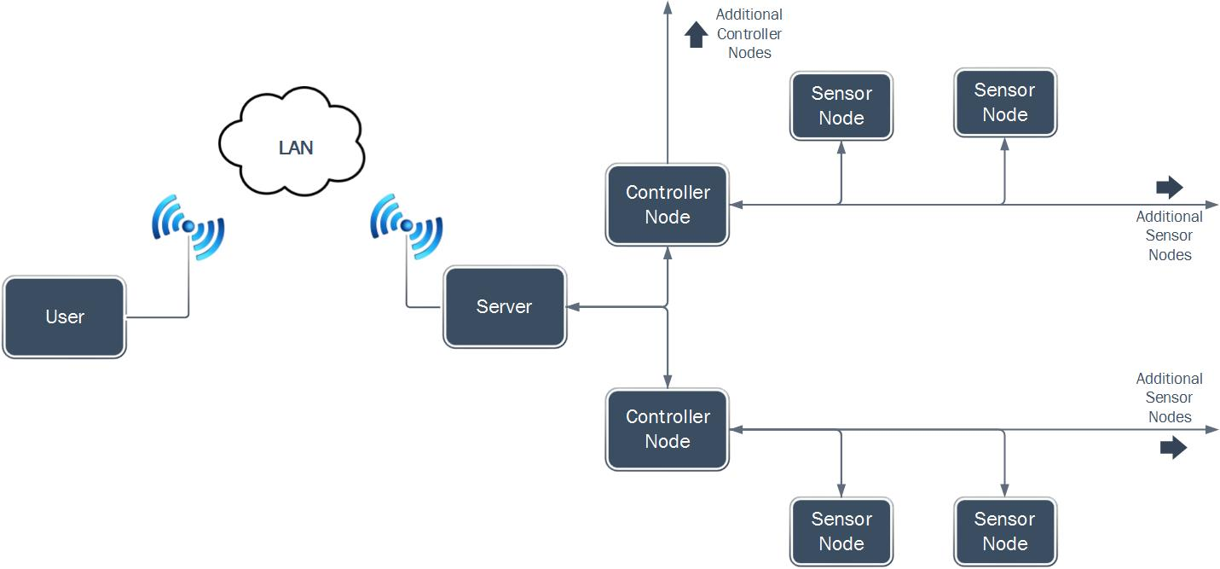
Design

Slide 9
Design Challenges
SPI & I²C Communication Interfaces
Addressing challenges
Minimize Cost, Maximize Versatility
Simple, Easy to Install and Manage
Store Data Internally
WiFi Network Connected
Power Supply
Single Power Supply for entire system

Slide 10
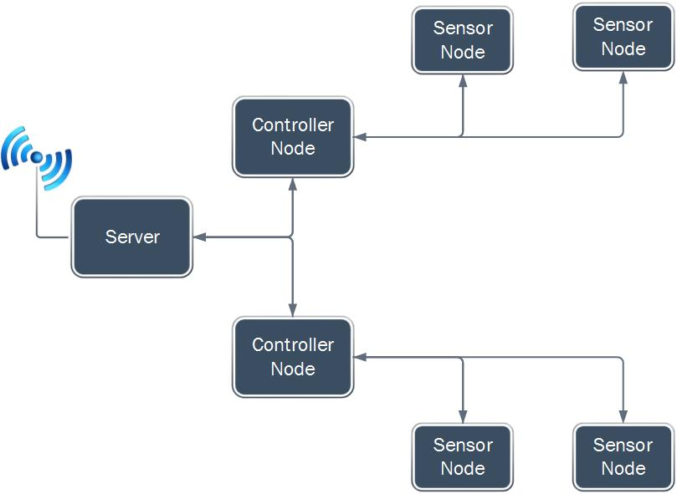
Demo Unit
1 Server
2 Controller Nodes
4 Sensors Nodes
2 Sensor Nodes per Controller Node

Slide 11
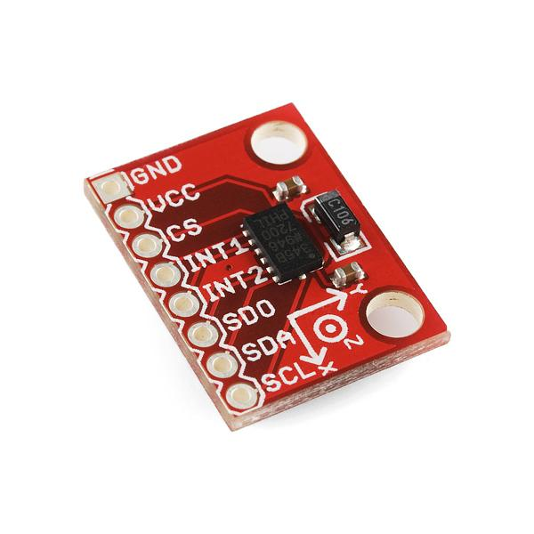
Sensor Node
Digital 3-Axis MEMS Accelerometer
Analog Devices ADXL345 Chip
SparkFun Breakout Board
SPI Interface
Sensor Node Select Chip (Demultiplexer)
NXP Semiconductors 74LV138N IC

Slide 12
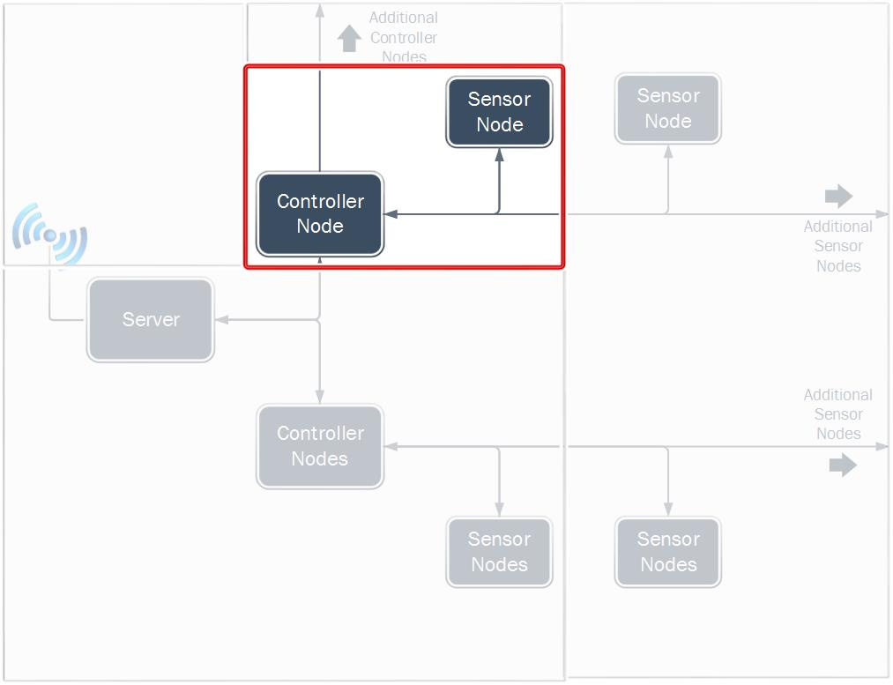
Sensor Node to Controller Node
Communication

Slide 13
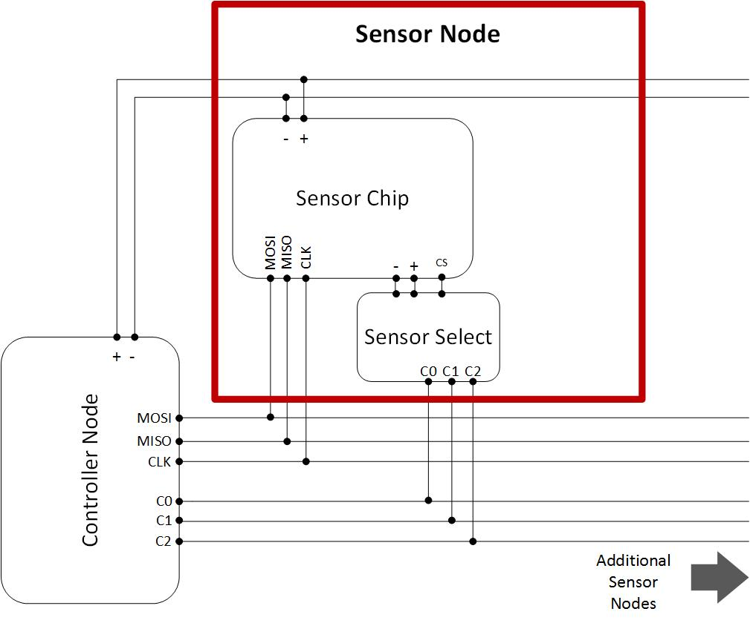
Sensor Node to Controller Node Circuit

Slide 14
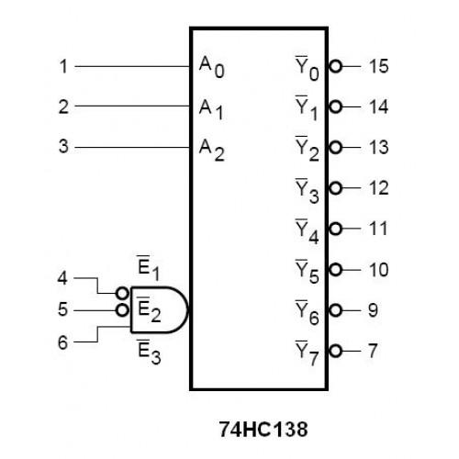
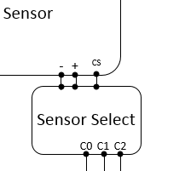
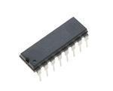
Sensor Select Chip - Demultiplexer
Sensor Select Chip allows less wires to control accelerometers over the SPI interface
NXP Semiconductors 74LV138N IC
3 Input Lines (3 Wires)
8 output options (Up to 8 Sensor Nodes)

Slide 15
Controller Node
Manages Data from Sensor Nodes
Each Sensor Node Checked Individually
Multiplexed SPI Chip Select Lines
Standard Data SPI Data Transfer from Master (Controller Node) to Slave (Sensor Node)
3 Chip Select Lines to Control up to 8 Devices
Data Retrieved by Server over serial UART connection

Slide 16
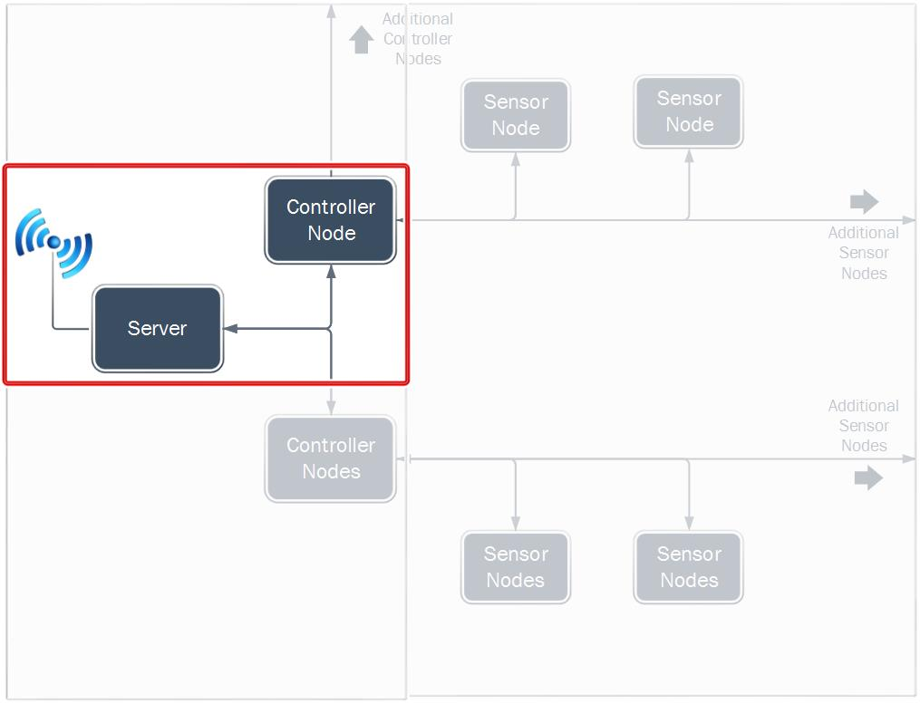
Server to Controller Node
Communication

Slide 17
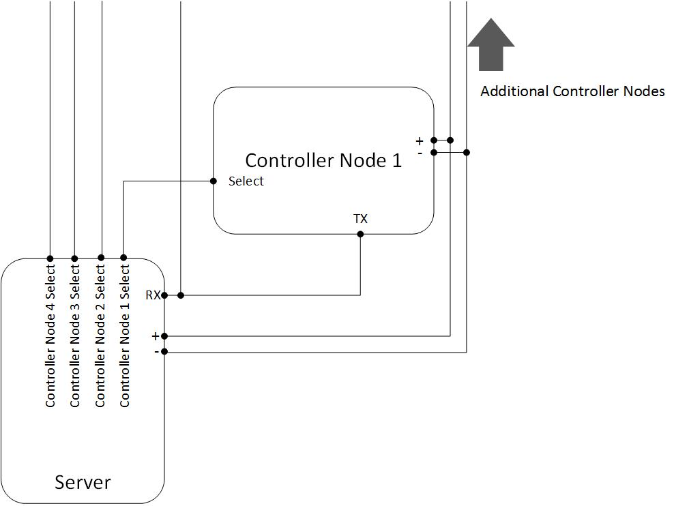
Controller Node to Server Circuit

Slide 18
Server
Digilent ChipKIT WF32
Integrated Microchip PIC32MX69F512L MCU
Integrated Microchip MRF24WG0MA WiFi Controller
Built in PCB Antenna (on WiFi Controller)
Server Manages Communication with Controller Node
Washer/Dryer Status and HTML File Stored on Server
WiFi Controller Handles Communication between server and LAN (SPI)
WPS Enabled, 802.11b/g, 5Mbps
WEP, WPA, WPA2-PSK Capable

Slide 19
Result
Movement Data Collected By Controller Node from Sensor Node (5 Min)
Controller Node Analyzes Movement Data
Makes Best Determination If The Washer/Dryer is:
Running
Completed a Cycle
Empty
Server Gathers Data From Controller Nodes (5 Min)
Server Updates Webpage HTML File
Server Sends Latest HTML File To User When Requested (Wi-Fi)

Slide 20
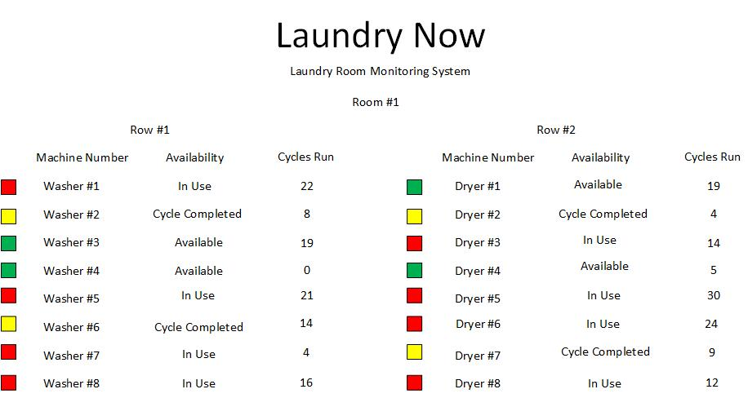
User Interface

Slide 21
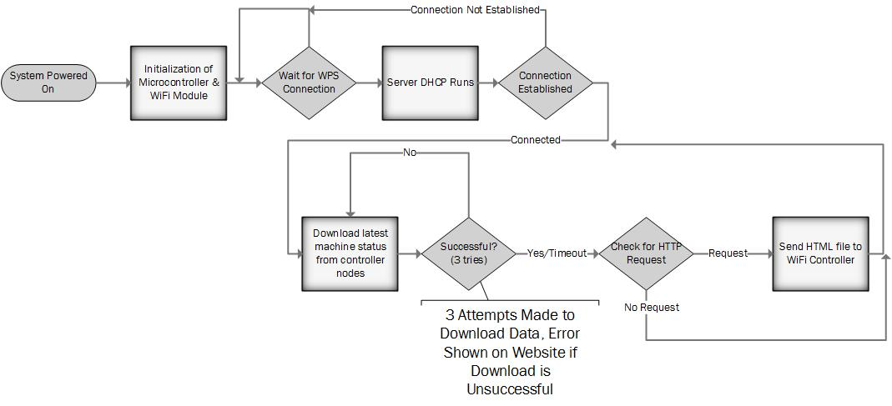
Server Flow Diagram

Slide 22
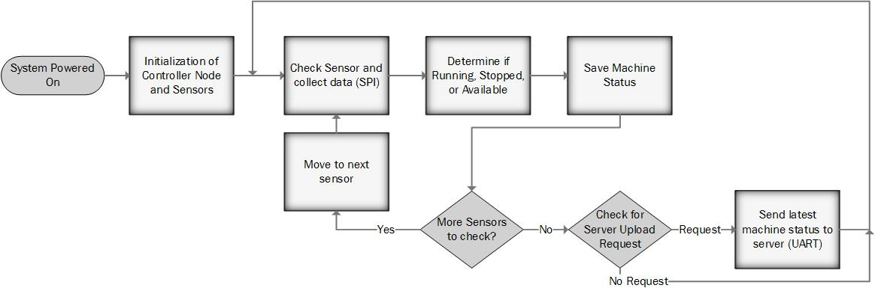
Controller Node Flow Diagram

Slide 23
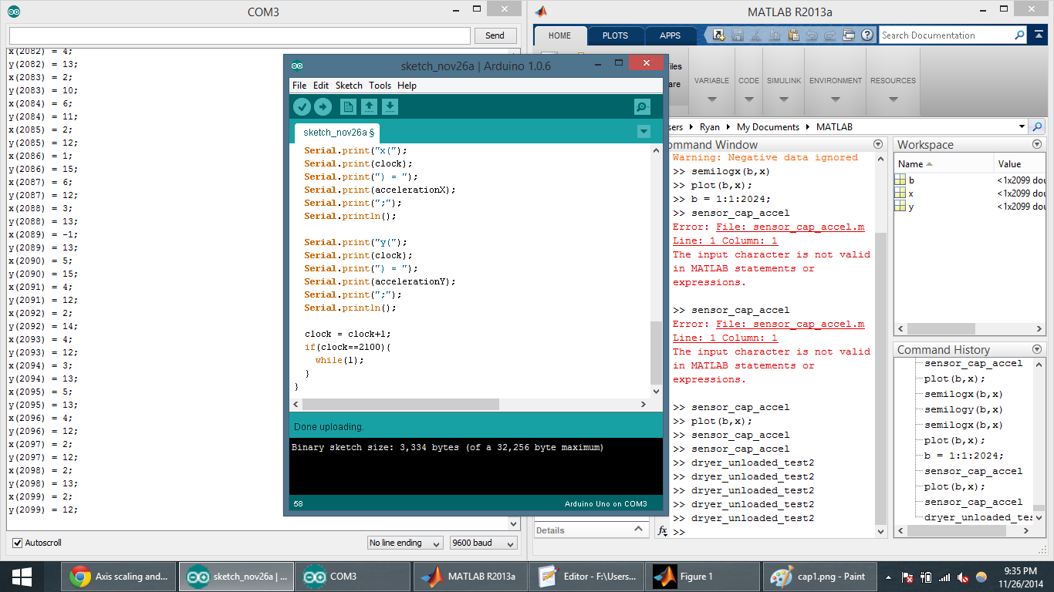
Sensor Test Results
Parallax 2-Axis MEMS Accelerometer
Digital Output to Arduino Uno
Data sent serially to laptop
Data Points plotted in MATLAB
Results analyzed

Slide 24
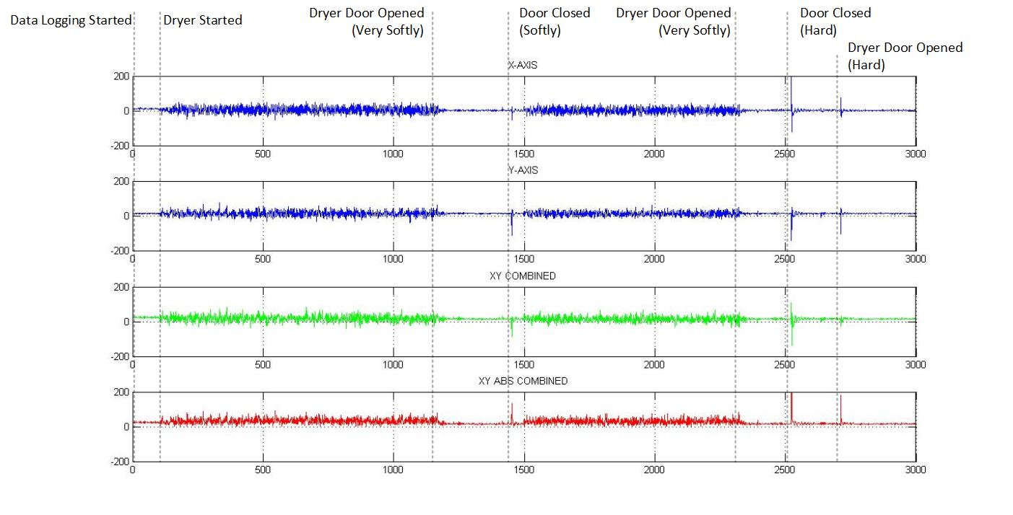

Slide 25
Potential Risks
Some Washer/Dryer Machines May Not Be Compatible
Washer/Dryer Too Quiet – Unable To Collect Sufficient Movement Data
Stacked Washer/Dryer Units – Unable To Differentiate Between Machines
Signal Degradation Between Sensors
Long Wire Distances May Cause Data/Clock Signals To Degrade
May Need To Add Distance Limitations
Add Buffers To Isolate Signal Between Sensor Nodes/Controller Nodes

Slide 26
Estimated Budget

Slide 27
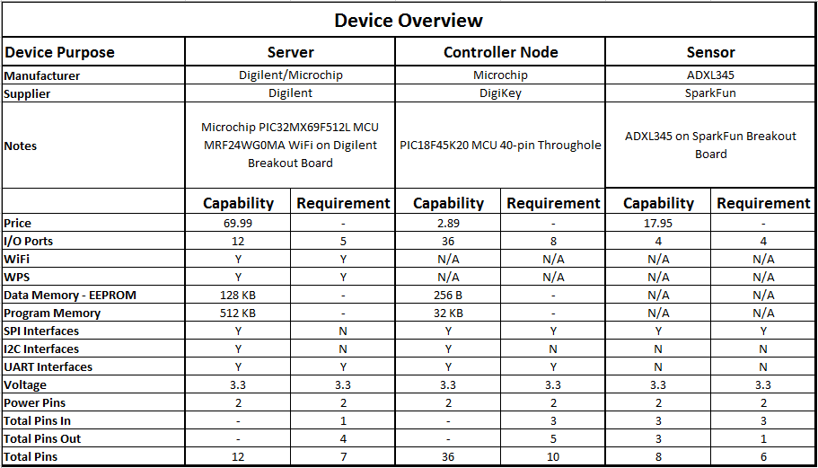

Slide 29
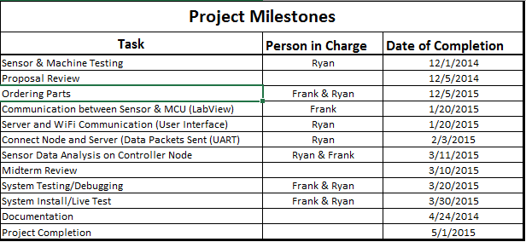
Project Milestones

Slide 30
Supporting Courses
Programming (CS115)
Fundamentals of Logic Design (ES112)
Digital Logic Design (ES210)
Advanced Programming (ES314)
Microprocessor and System Design (ES310)
Wireless Communication (ES485)
Intro to Networking (ES465)

Slide 31
Questions/Comments
Laundry Now
Senior Design Project Proposal Submitted By:
Frank Monforte, Ryan Russell
Sonoma State University Department of Engineering Science
Advisor: Dr. Farid Farahmand
laundrynowssu.weebly.com

Slide 32
References
http://www.macgray.com/
Mac Gray is the inventor and supplier of LaundryView and all of the products needed to run LaundryView. 11/15/2014
http://www.campus-solutions.net/index.html
Campus-solutions is one of the many features that is offered by Mac Gray. This website shows how LaundryView has been implemented in Colleges across the country and how it has improved the efficiency of college laundry facilities. 11/15/2014
http://www.amazon.com/LG-Electronics-RLM20K-Laundry-Monitoring/dp/B0012OMY2K
Is the main selling source for LG’s Remote Laundry Monitoring System, provides cost along with description of what the product does and some reviews form customers. 11/15/2014
http://www.maytag.com/Laundry-1/Laundry_Laundry_Appliances_Washers-3/102120050+4294966015/
Provides the estimated cost of the Maytag washers and dryers that Mac Gray offers as part of their laundry facility service, and the machines needed to allow for the use of LaundryView. 11/15/2014
http://www.nmhc.org/Content.aspx?id=4708
This link provides the number of residents the live in apartment complexes in the state of California and the whole country. 12/4/2014

Slide 33
References
http://www.analog.com/static/imported-files/data_sheets/ADXL345.pdf
Analog Devices ADXL345 Data Sheet. 12/1/2014
https://www.sparkfun.com/products/9836
SparkFun Product Page & Details for ADXL345 Breakout Board. 12/1/2014
http://ww1.microchip.com/downloads/en/DeviceDoc/41303G.pdf
Microchip PIC18F45K20 Data Sheet. 12/1/2014
http://ww1.microchip.com/downloads/en/DeviceDoc/61156H.pdf
Microchip PIC32MX69F512L Data Sheet. 12/1/2014
http://ww1.microchip.com/downloads/en/DeviceDoc/70686B.pdf
Microchip MRF24WG0MA Wi-Fi Controller. 12/1/2014
https://www.digilentinc.com/Products/Detail.cfm?NavPath=2,892,1193&Prod=CHIPKIT-WF32
Digilent ChipKit WF32 Product Page. 12/1/2014

Slide 34
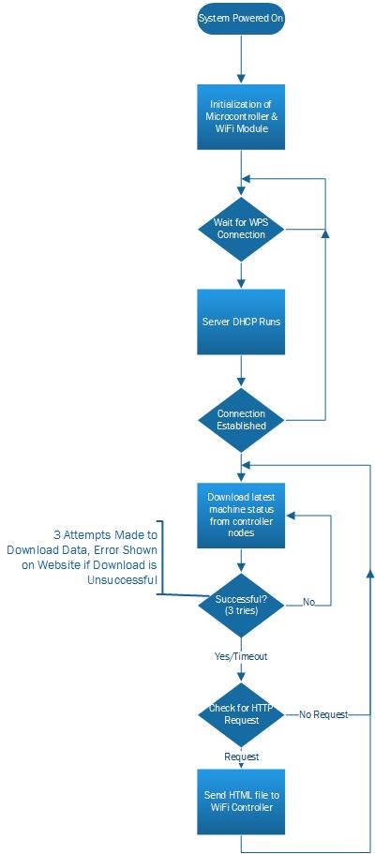
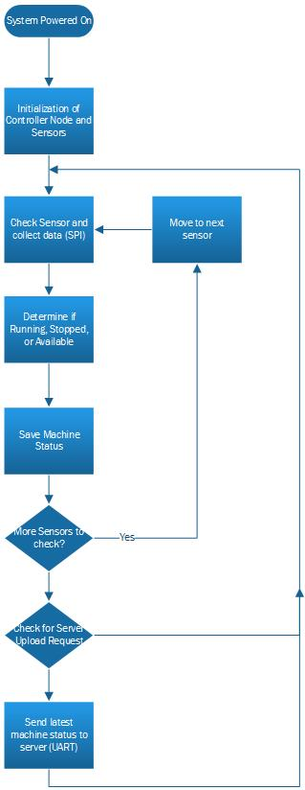

Slide 35
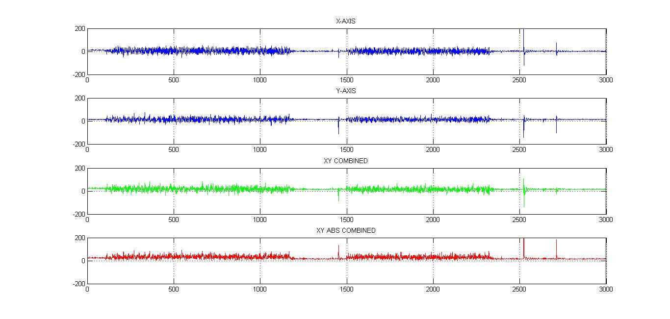

Slide 36
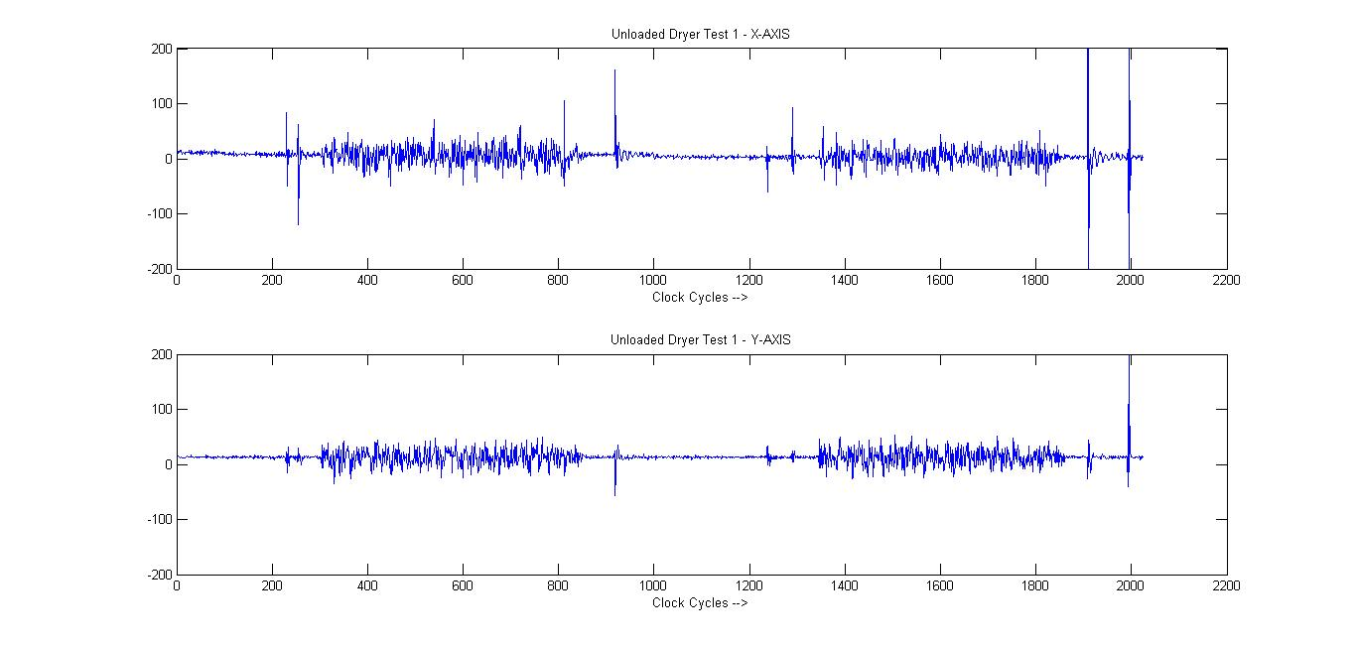

Slide 37
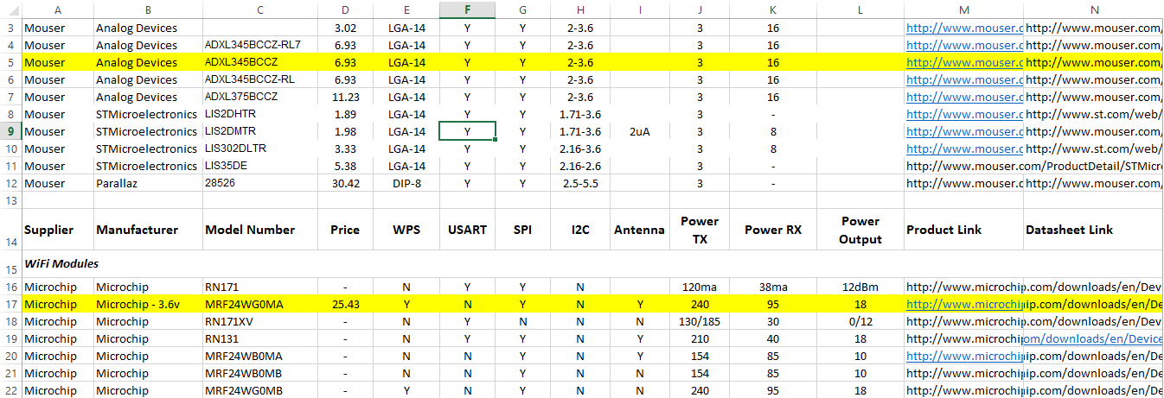
Product Research

Slide 38
Device Links

